Slide 1
Module 3
Databinding

Slide 2
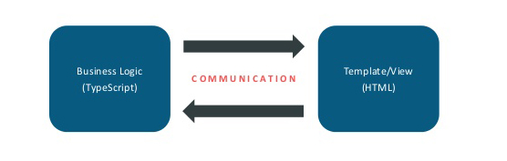
What is Databinding
Databinding can be regarding as communication between your typescript code(business logic) and what the user sees(html template).

Slide 3
Typescript code to Html Template
String Interpolation {{ data }}
<img src=“{{url}}”/>
Property binding [property] = “data”
<img [src]=“url”/>

Slide 4
Html template to Typescript code
Event binding (event) = “Expression”)
<button (click)=“onClick()”></button>

Slide 5
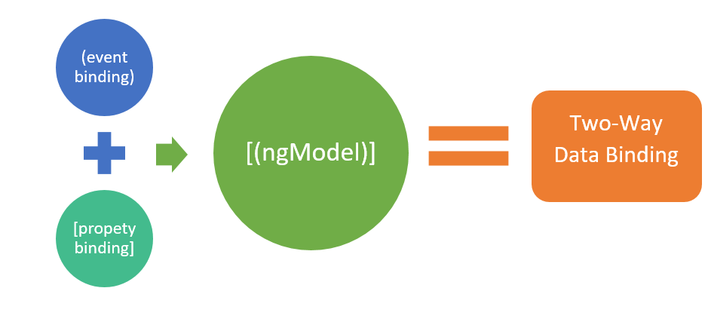
Combination of Both
Two-way-binding [(ngModel)] = “data”
<input [(ngModel)]=“data”/>

Slide 6
Custom Property Binding
We can use property binding to bind to properties of our own components
By default properties of a component are only accessed from within the component
To enable binding we use @Input() decorator
You can assign an alias to this decorator
@Input() bankName: string;
@Input('account-id') id: string;

Slide 7
Custom Event Binding
We can use event binding to bind to events from our own components
To event binding we use @Output() decorator and EventEmitter<type> class
You can assign an alias to this decorator
@Output() voted = new EventEmitter<boolean>();
@Output(‘citizenVoted’) voted = new EventEmitter<boolean>();

